Slide 1
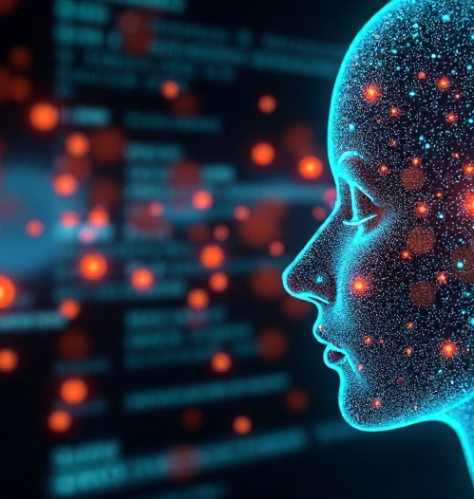
Introduction
Practical Uses of AI on a Daily Basis for Developers
Presenter Name: [Your Name]
Overview of AI tools for modern developers
Importance of integrating AI in daily workflows

Slide 2
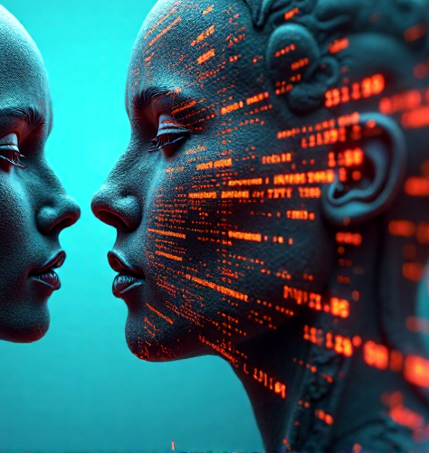
Overview of AI's Role in Development
Brief definition of AI and its relevance to development
Types of AI: Machine Learning, Natural Language Processing, etc.
The evolving relationship between AI and software development

Slide 3

AI Coding Assistants
Tools: GitHub Copilot, Tabnine
Benefits: Increases productivity, reduces code errors, enhances learning
Use Cases: Auto-completing code, suggesting best practices

Slide 4

AI in Documentation and Knowledge Management
Tools: NotebookLM, OtterAI
Benefits: Streamlining documentation process, making learning resources accessible
Use Cases: Automated meeting notes, documentation generation from code comments

Slide 5

Efficient Research with AI
Tools: Perplexity, Google Bard, Kuki
Benefits: Fast and relevant information retrieval, improved decision-making
Use Cases: Answering technical queries, finding best libraries and frameworks

Slide 6
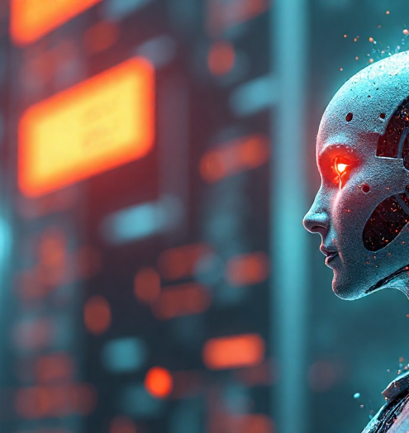
Enhancing Testing and Debugging
Tools: Test.ai, Diffblue
Benefits: Automated testing, predictive debugging
Use Cases: Smart unit tests generation, identifying code vulnerabilities

Slide 7

AI in Code Review Processes
Tools: CodeGuru, Chi
Benefits: Automated code quality checks, faster review cycles
Use Cases: Identifying anti-patterns, suggesting improvements

Slide 8

Questions & Answers
Open floor for queries
Clarifications on discussed tools and practices
Gathering feedback on AI tools usage in daily dev work

